Slide 1
Group 4’s Project
CREATED BY:
Bentley Epple
Nasir Muhumed
Sam Gerend
Ryan

Slide 2
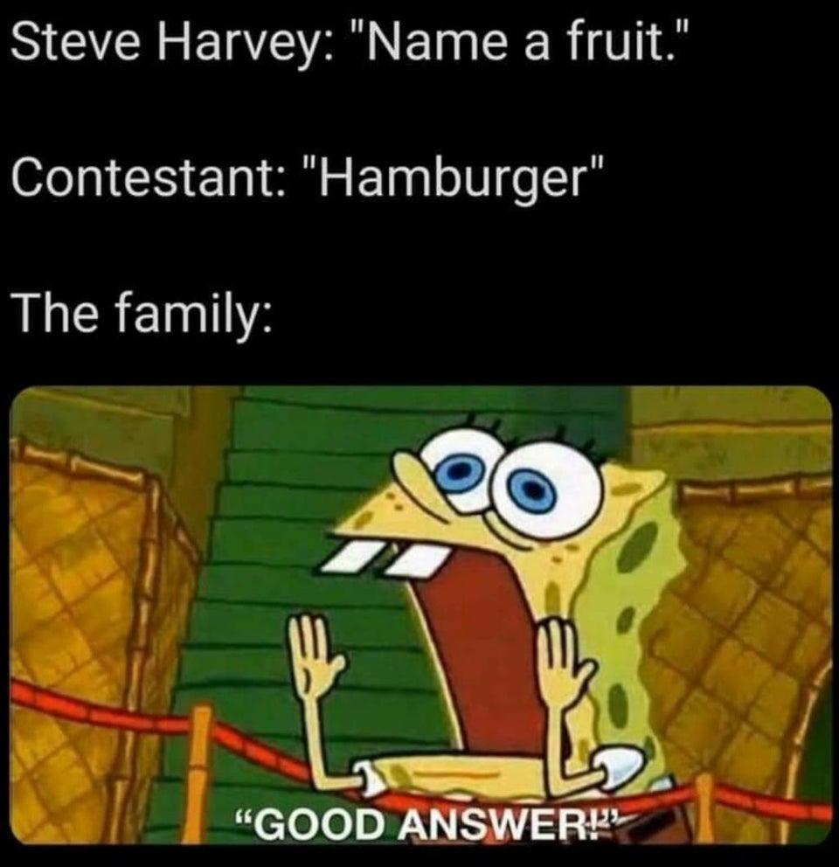

Slide 3
Reminder
What we are building:
A Family Feud Game made for educators that is easy to use.
Why are we building:
To make class participation fun and engaging.
For Whom:
We are built this application for Bryan Lilly, a Professor of Marketing.

Slide 4
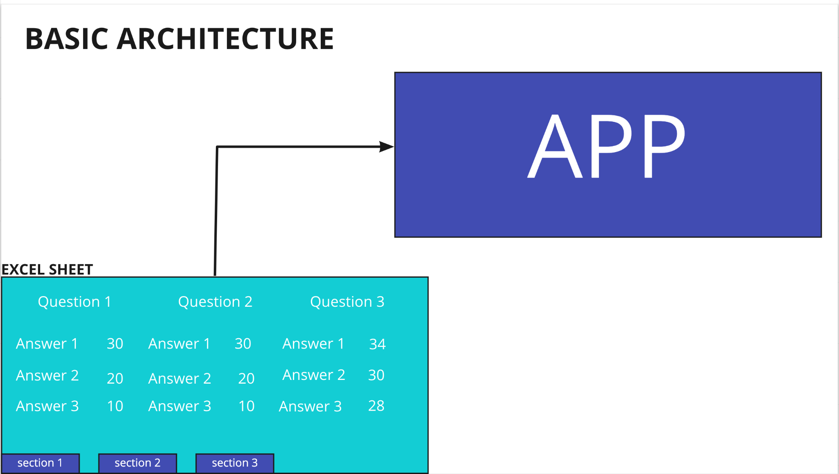
Basic Big Picture

Slide 5
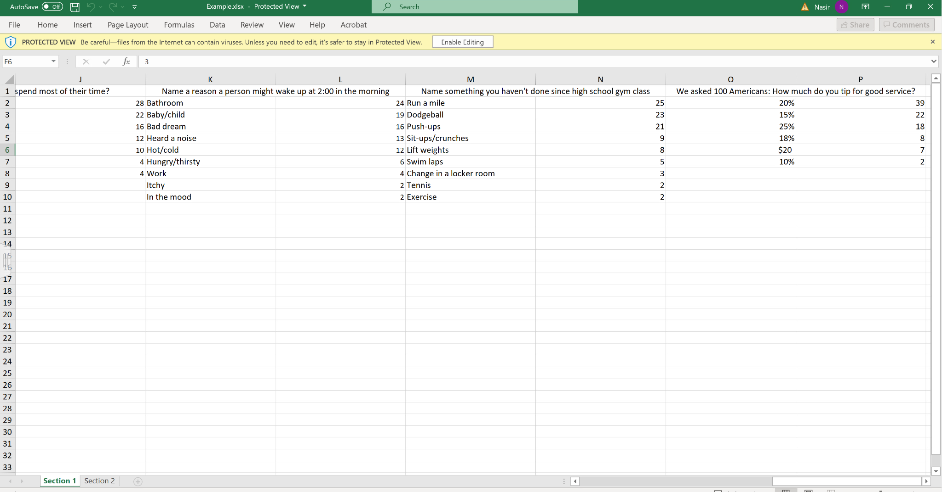

Slide 6
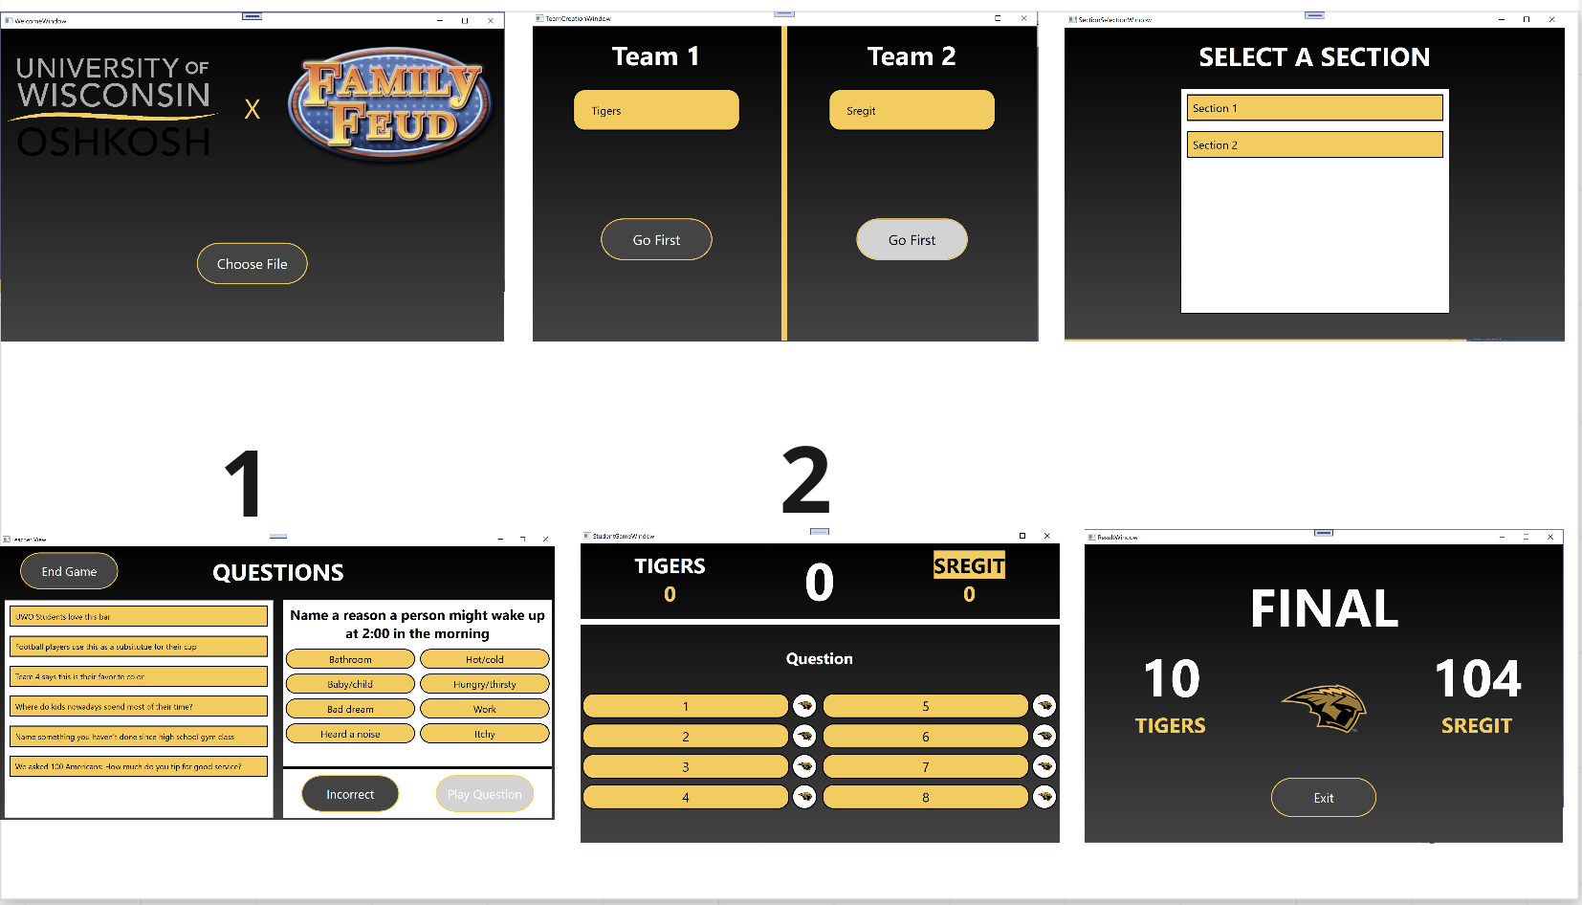
UI WALK THROUGH

Slide 7
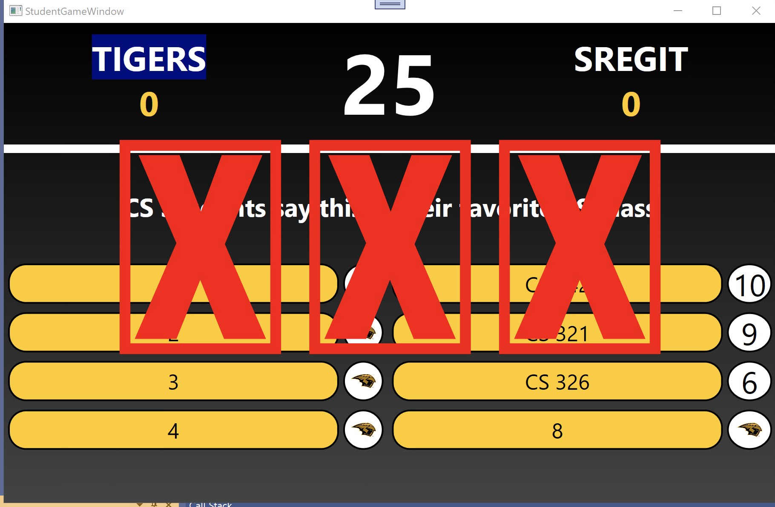

Slide 8
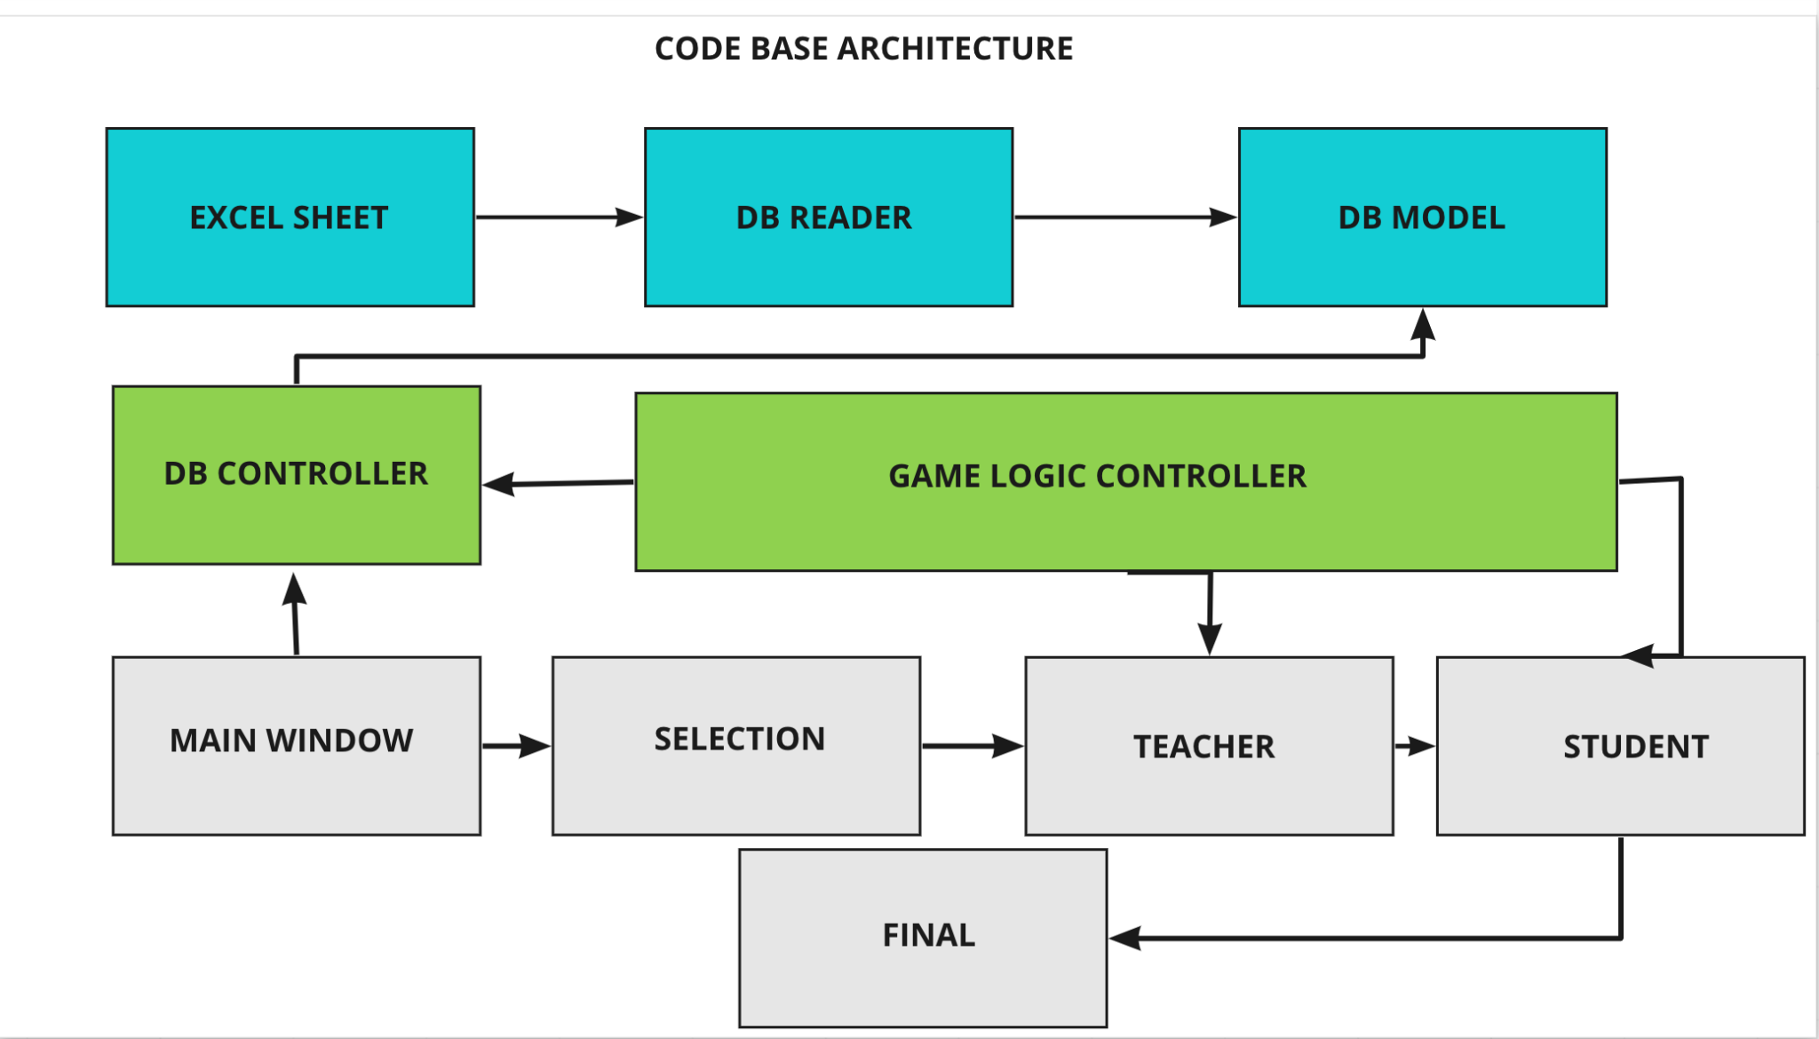

Slide 9
APP DEMO

Slide 10

ANY QUESTIONS

